Slide 1


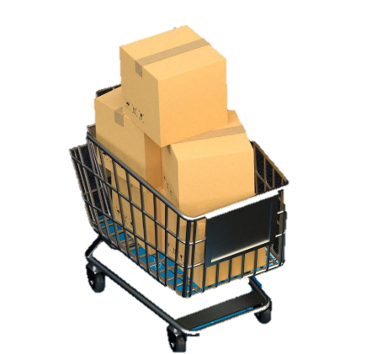


Presented By - Sonali Gupta
Consumer Goods
Ad-hoc Insights
Provide Insights to Management in Consumer Goods Domain

Slide 2
Contents
Project Brief
Project Execution
Data Understanding
Summary
Ad-hoc Requests and Insights

Slide 3
Project Brief
About Company -
Problem Statement -
Objective -
Atliq hardware management facing problems to get enough insights to make quick and smart data-informed decisions.
They want to expand their data analytics team by adding several junior data analysts.
Tony Sharma, their data analytics director wanted to hire someone who is good at both tech and soft skills. Hence, he decided to conduct a SQL challenge which will help him understand both the skills.
Atliq Hardwares is an imaginary company, which is one of the leading computer hardware producers in India and well expanded in other countries too.
The target audience of this dashboard is top-level management. So, the presentation has to be creative that help management to take important decisions.
In this task, it has been asked to run a SQL queries to answer the 10 ad hoc requests for which the business needs insights.

Slide 4
Project Execution Process
Load atliq hardware database ‘gdb023’ into MySQL provided by atliq data analyst director Tony Sharma.
Understanding and analyzing the provided datasets of consumer domain for the fiscal year of 2020 and 2021.
Run the SQL queries for 10 ad-hoc reqests and provide insights to the company.
Load all the tables in Microsoft Power BI for visualization.
Create the PowerPoint presentation to show all the insights.

Slide 5
Data Understanding
The database consists of 6 tables of which 2 are dimension table and 4 are fact tables.
contains customer-related data
dim_product
contains product-related data
fact_gross_price
contains gross price information for each product
fact_sales_monthly
fact_manufacturing_cost
fact_pre_invoice_deductions
dim_customer
contains the cost incurred in the production of each product
contains pre-invoice deductions information for each product
contains monthly sales data for each product.

Slide 6
Ad-hoc Requests and Insights

Slide 7
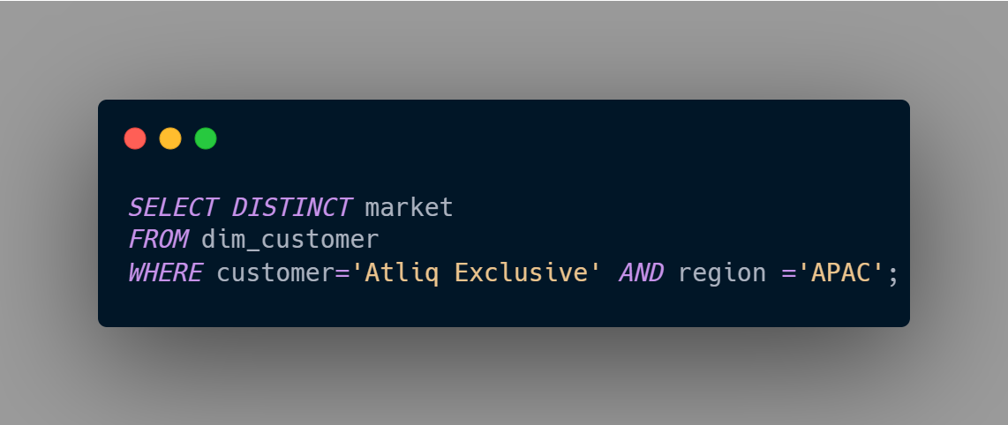

Provide the list of markets in which customer "Atliq Exclusive" operates its business in the APAC region.
Request 1
SQL Query
Output

Slide 8
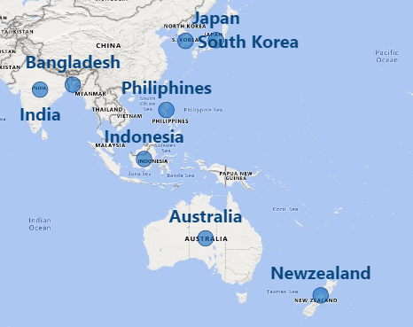
Visual Output
Insights
There are 8 countries in which the customer "Atliq Exclusive" operates its business in the APAC region.

Slide 9
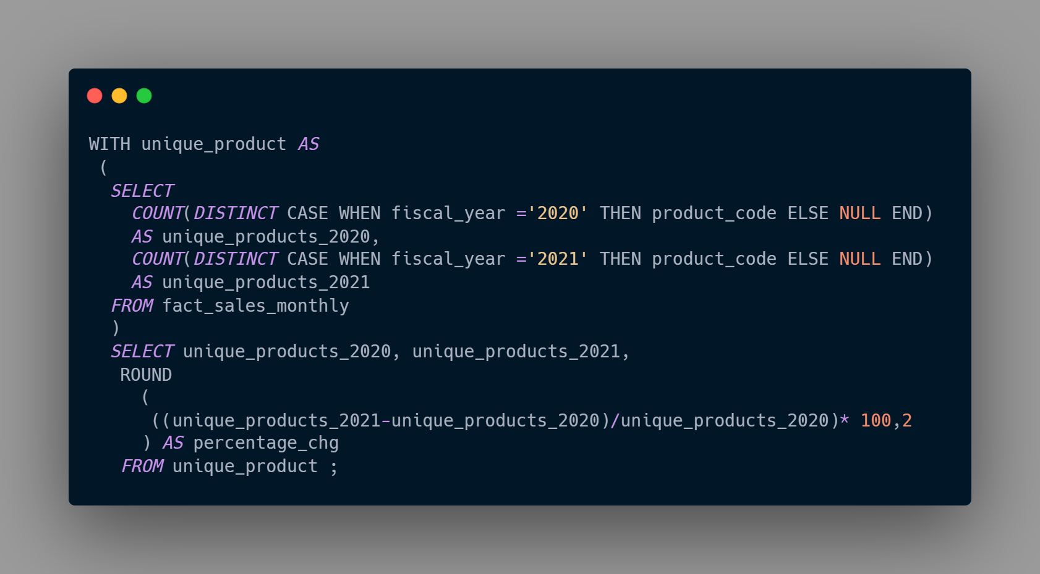

What is the percentage of unique product increase in 2021 vs. 2020?
Request 2
SQL Query
Output

Slide 10
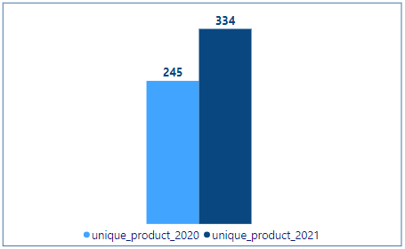
Visual Output
Insights
There are 334 unique products in 2021 and 245 unique products in 2020. It is clearly seen that there is rise in fiscal year 2021.
36.33% growth in unique products from 2020 to 2021.

Slide 11
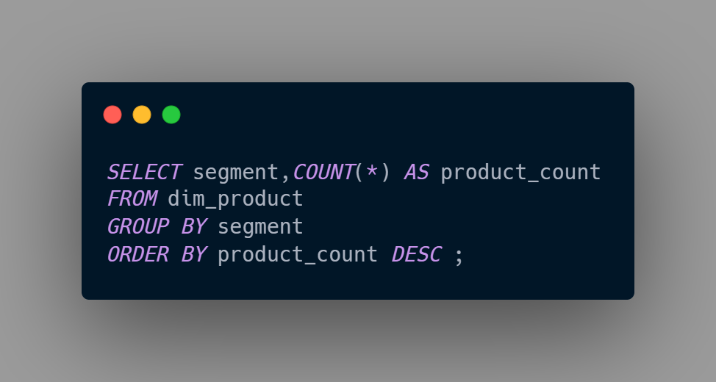
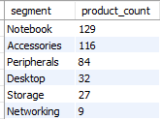
Provide a report with all the unique product counts for each segment and sort them in descending order of product counts. The final output contains 2 fields.
Request 3
SQL Query
Output

Slide 12
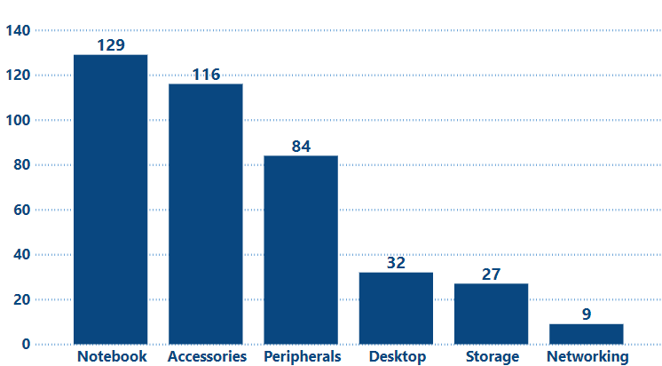
Visual Output
Insights
Segment notebook has highest unique products i.e.129 while segment networking has lowest unique products i.e.9.
Company need to focus on segments like- desktop, storage, networking because their total count is very less then in comparison to top 3.

Slide 13
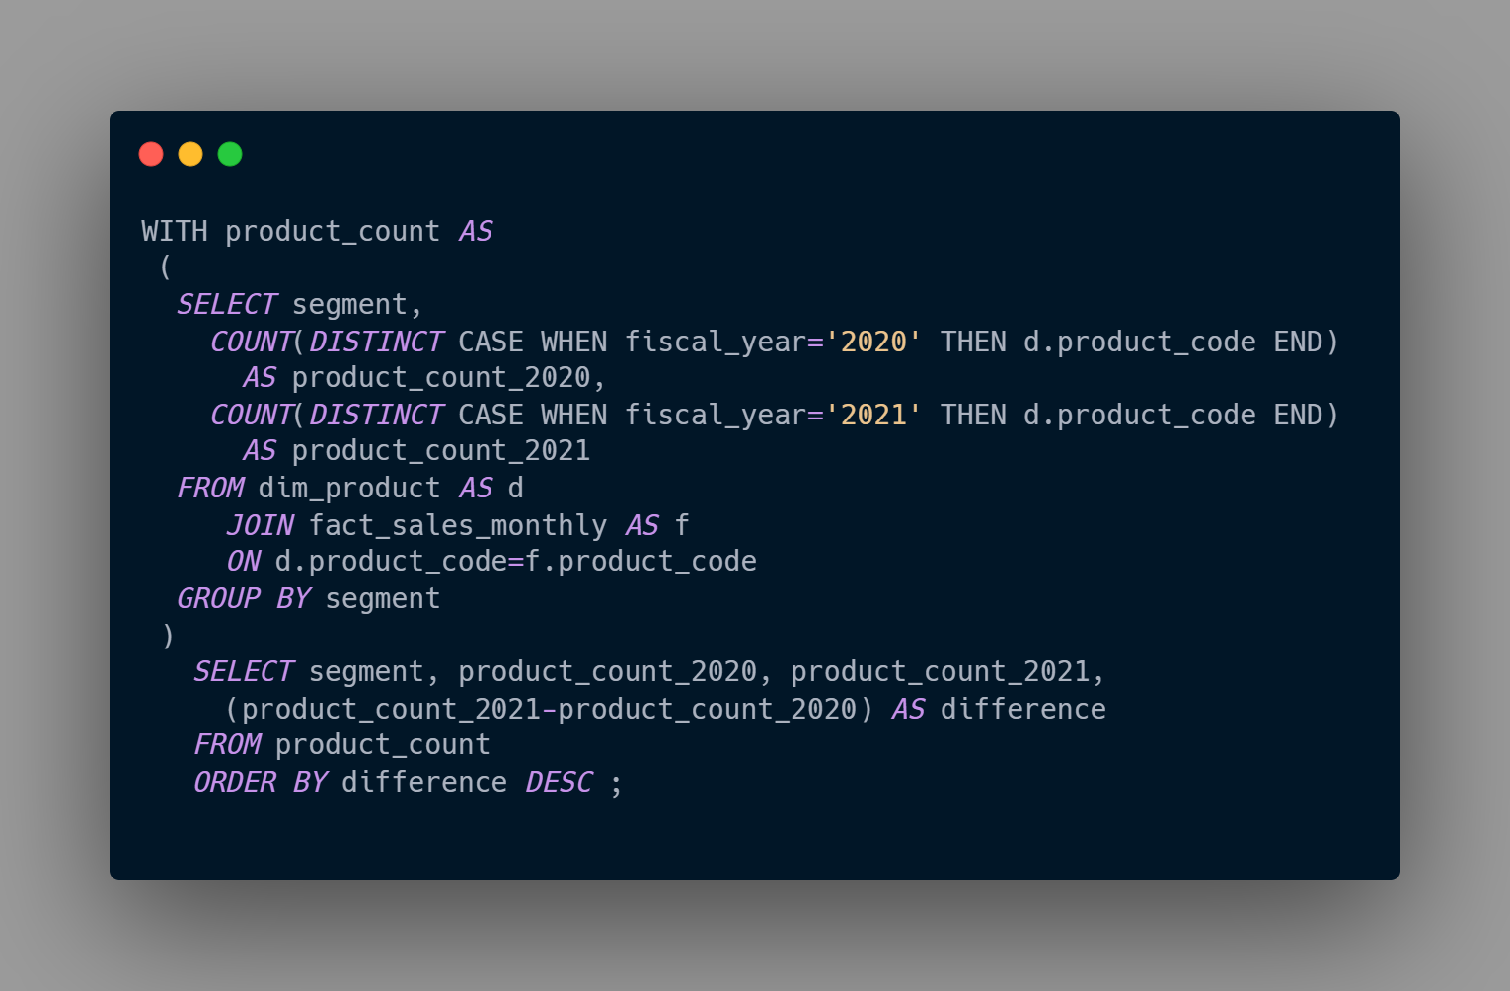
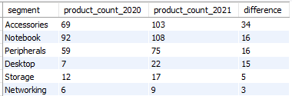
Which segment had the most increase in unique products in 2021 vs 2020?
Request 4
SQL Query
Output

Slide 14
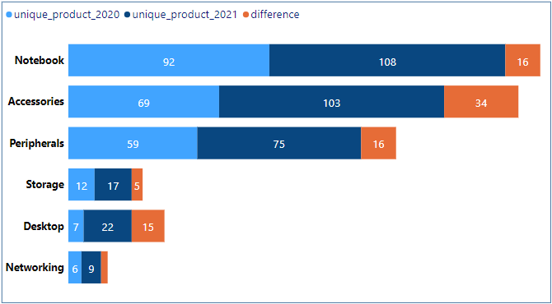
Visual Output
Insights
Every segment had increased in unique products in 2021 vs 2020.
Accessories segment had the largest increase in production.
Networking segment experienced the slower production growth.

Slide 15
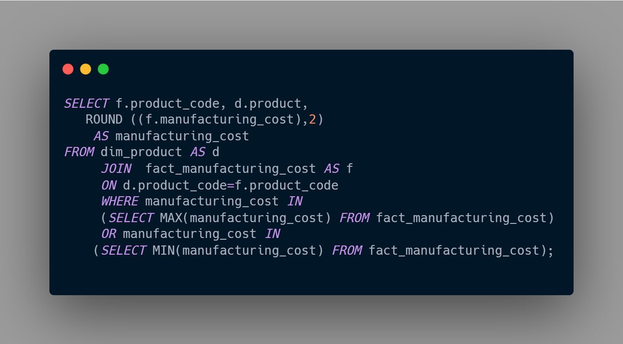

Get the products that have the highest and lowest manufacturing costs.
Request 5
SQL Query
Output

Slide 16
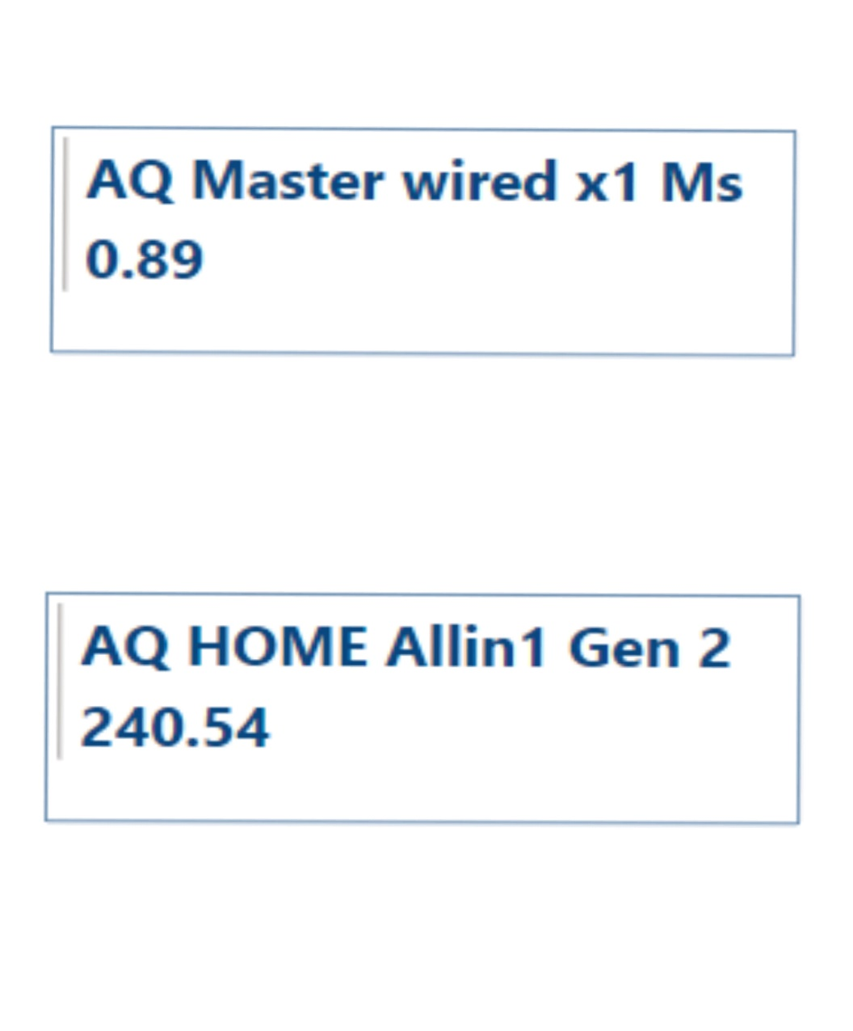
Visual Output
Insights
AQ Master wired x1 Ms (Mouse) has the lowest manufacturing cost.
AQ HOME Allin 1 Gen 2 (Desktop) has the highest manufacturing cost.

Slide 17
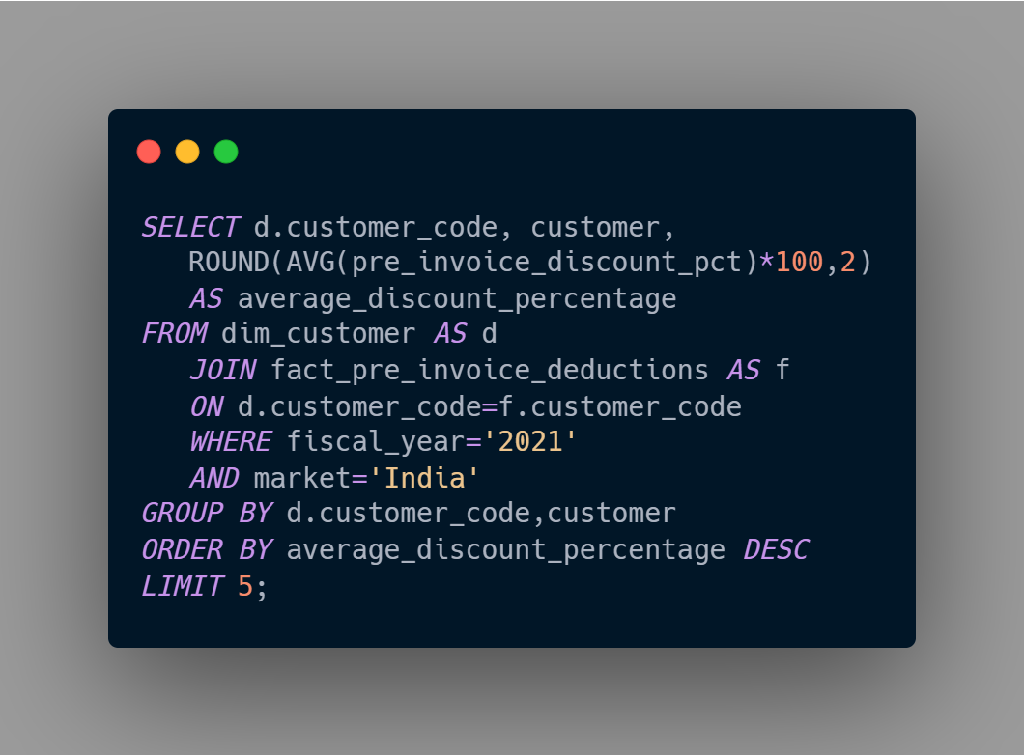
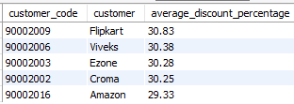
Generate a report which contains the top 5 customers who received an average high pre_invoice_discount_pct for the fiscal year 2021 and in the Indian market.
Request 6
SQL Query
Output

Slide 18
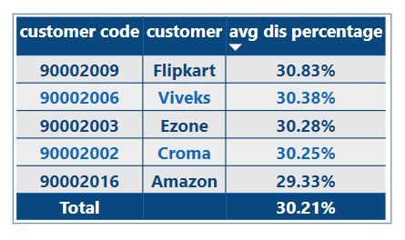
Visual Output
Insights
Flipkart has highest pre invoice discount percentage.
Amazon has lowest pre invoice discount percentage.

Slide 19
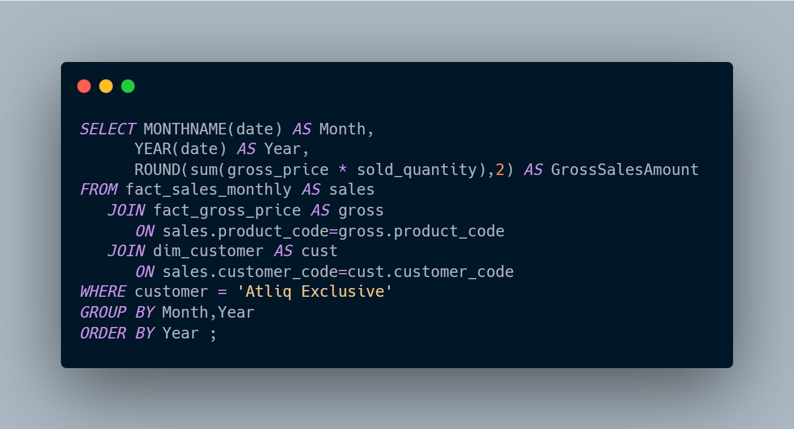
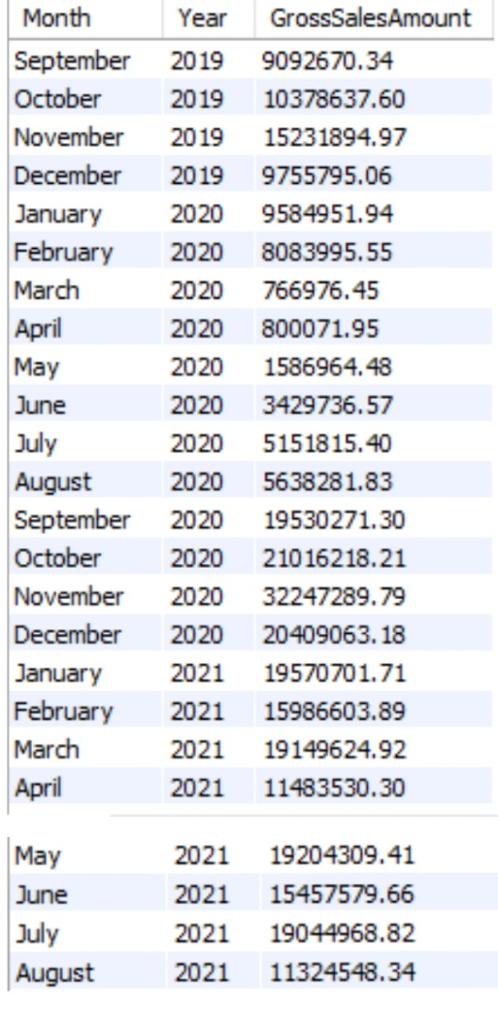
Get the complete report of the Gross sales amount for the customer “Atliq Exclusive” for each month.
Request 7
SQL Query
Output

Slide 20
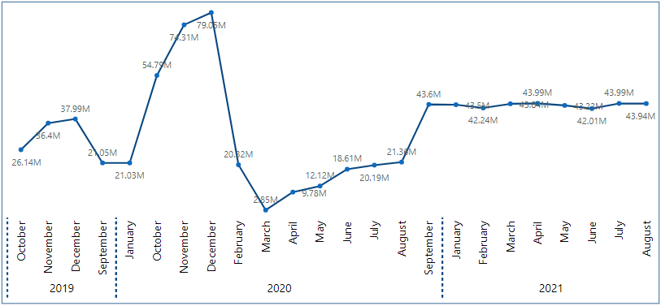
Visual Output
Insights
Highest gross sales in the month of November 2020.
Lowest gross sales in the month of March 2020.
In 2021, January has the highest gross sales amount.

Slide 21
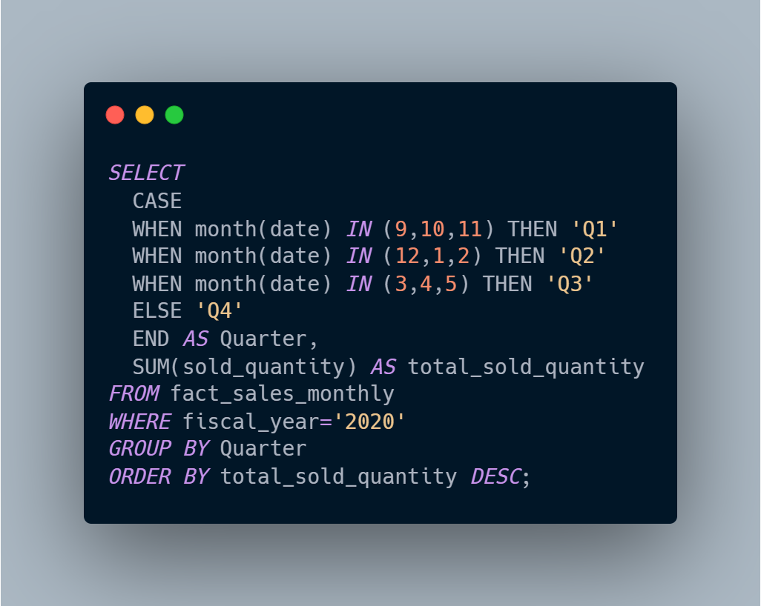

In which quarter of 2020, got the maximum total_sold_quantity?
Request 8
SQL Query
Output

Slide 22
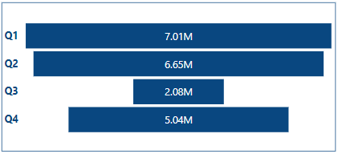
Visual Output
Insights
Quarter 1 has the maximum total sold quantity (7005619).
Quarter 3 has the minimum total sold quantity (2075087).

Slide 23
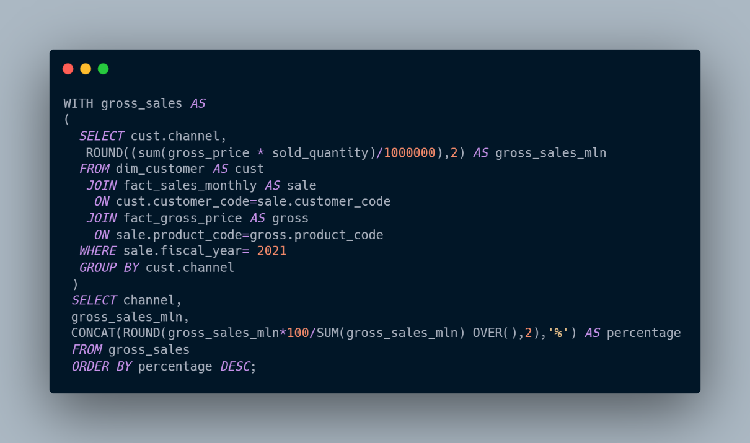

Which channel helped to bring more gross sales in the fiscal year 2021 and the percentage of contribution?
Request 9
SQL Query
Output

Slide 24
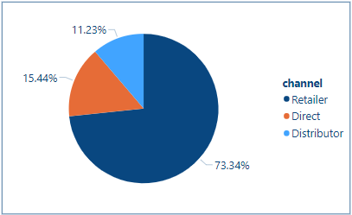
Visual Output
Insights
Retailer channel helped to bring more gross sales with the percentage of contribution is 73.34%.
Distributor channel has less gross sales with the percentage of contribution is 11.23%.

Slide 25
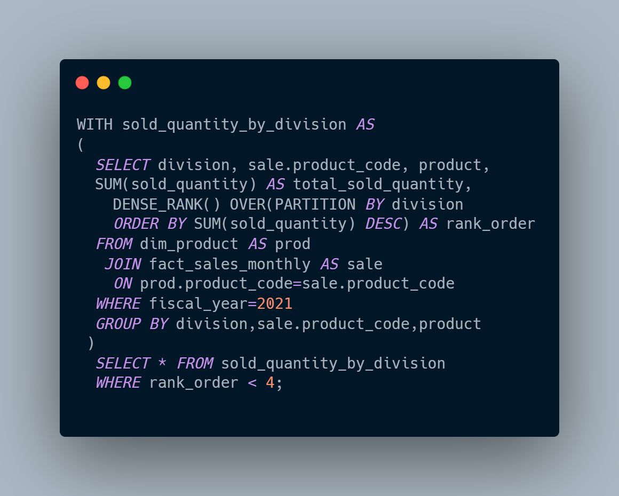
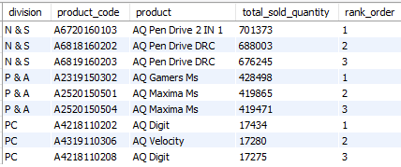
Get the Top 3 products in each division that have a high total_sold_quantity in the fiscal_year 2021?
Request 10
SQL Query
Output

Slide 26
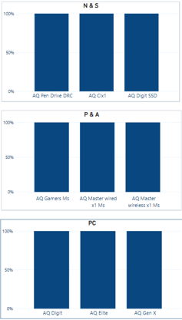
Visual Output
Insights
There are 3 divisions – N&S, P&A, PC.
In N&S division, AQ Pen drive 2 IN 1. In P&A division, Q Gamers MS. In PC division, AQ Digit product has the highest ranking.

Slide 27
Summary
There are total 397 products which is divided in 3 division- PC, P&A, N&S. It can be divided into 6 segments- Notebook, Accessories, Peripherals, Desktop, Storage, Networking. These segments are further divided into 14 categories.
Atliq is having strong relationship with flipkart in comparison to other customers.
Q2, Q3 shows the decline in total sales probably due to covid-19 pandemic outbreak.
Notebook, Accessories, Peripherals segments give more sales to the company as more products (329) are choose by the customer whereas Desktop, Storage, Networking give less sales to the atliq hardware because less products (68) are choose by the customers.
In financial year 2021, atliq gross sales is alternatively increasing and decreasing.
Retailer channel helped to bring more gross sales (73.22%) in the fiscal year 2021.
N&S division has highest sold products than other divisions and product pen drives has highest sold quantity.

Slide 28
Thank You

